Slide 2
develop understanding about basics of relative speed, faster and slower trains,
derive important facts and formulae relating to various problems on trains.

Slide 3
Basics and Important Facts
If a train overtakes a pole/man/milestone, then the distance covered in overtaking is equal to the length of the train.
Time taken by a train of length ‘a’ m to pass a pole/standing man/milestone/signal post is equal to the time taken by the train to cover ‘a’ m.

Slide 4
Basics and Important Facts
If a train overtakes a bridge/tunnel/platform/another train, then the distance covered is equal to the sum of the two lengths i.e., sum of the length of the train and length of bridge/tunnel/platform/another train.
Time taken by a train of length ‘a’ m to pass a stationary object/bridge/tunnel/platform/another train of length ‘b’ m is time taken by train to cover (a + b) m.

Slide 5
Basics, Important Facts and Formulae
When two trains are moving in opposite direction
  Relative Speed is equal to the sum of the speed of both trains.
  Speed of faster train + Speed of Slower train
  Suppose two trains or two bodies are moving in opposite directions at a m/s and b m/s.
  Relative Speed = (a + b) m/s

Slide 6
Basics, Important Facts and Formulae
When two trains are moving in same direction
  Relative Speed is equal to the difference of the speed of both trains.
  Speed of faster train – Speed of Slower train
  Suppose two trains are moving in the same direction at a m/s and b m/s (where a > b).
  Relative Speed = (a – b) m/s

Slide 7
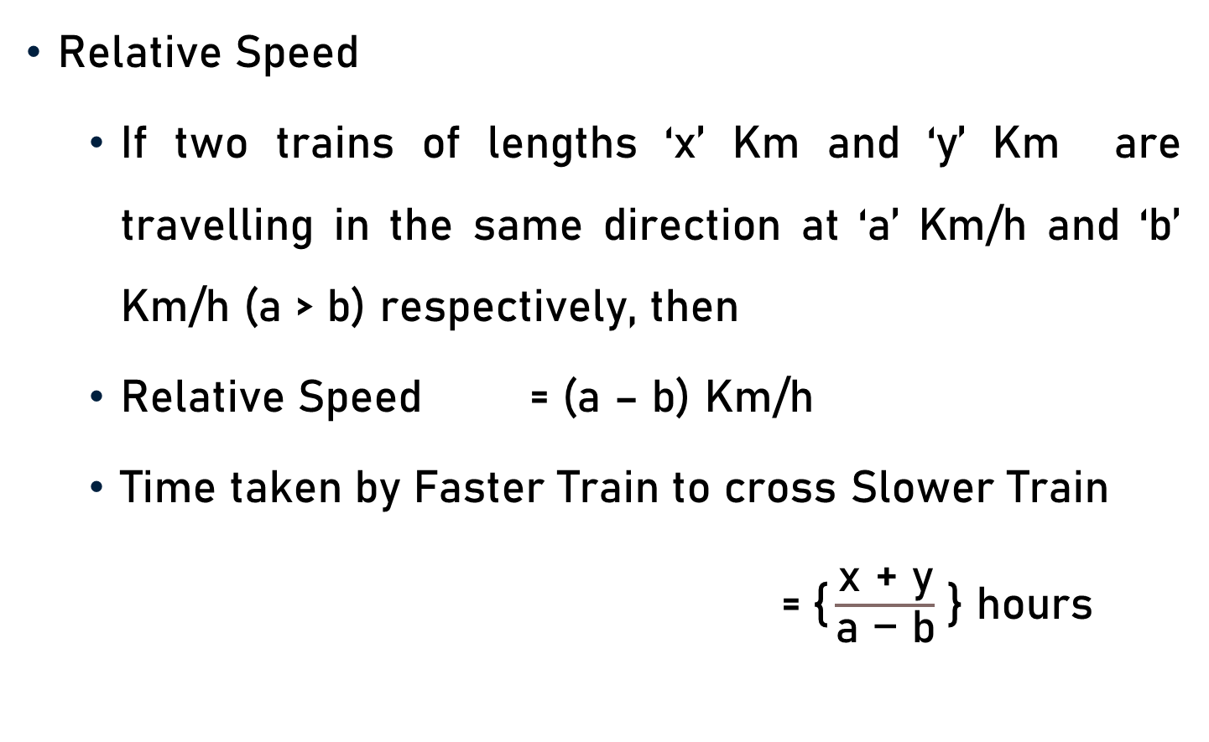
Basics, Important Facts and Formulae
Relative Speed
  If two trains of lengths ‘x’ Km and ‘y’ Km are travelling in the same direction at ‘a’ Km/h and ‘b’ Km/h (a > b) respectively, then
  Relative Speed = (a – b) Km/h
  Time taken by Faster Train to cross Slower Train
  =$\text{\{}\frac{\text{x} \text{+ }\text{y}}{\text{a} \text{−} \text{b}}$ } hours

Slide 8
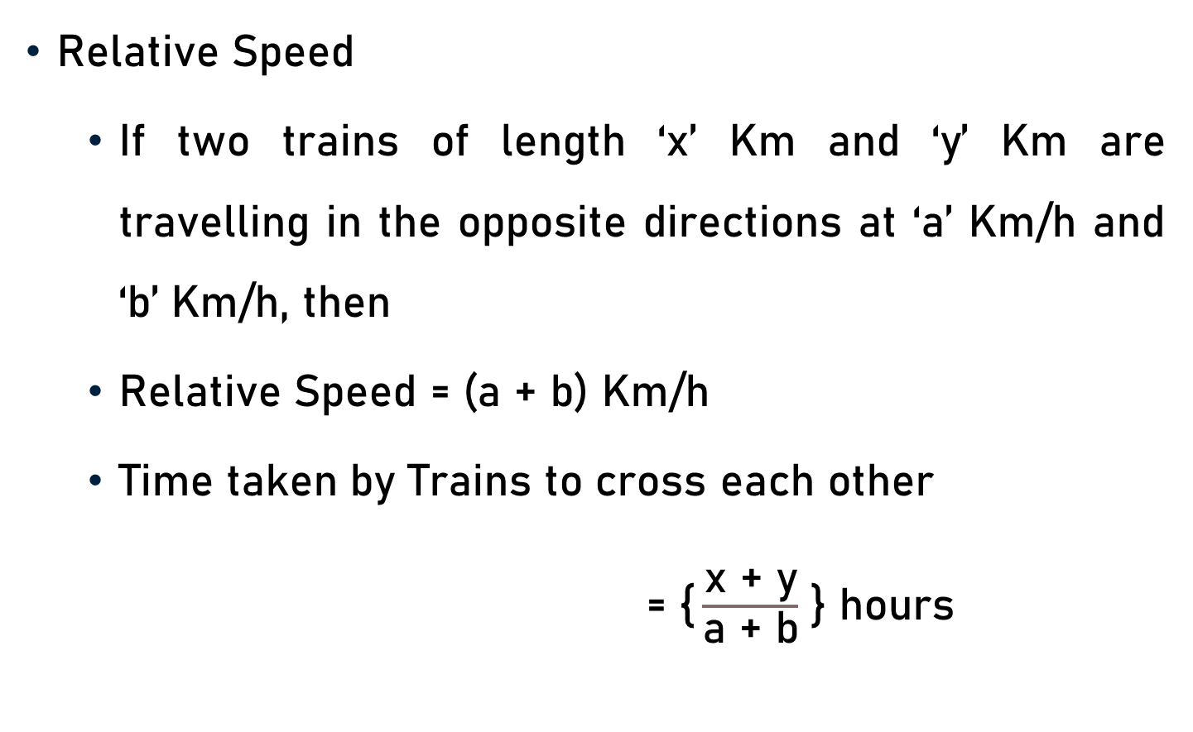
Basics, Important Facts and Formulae
Relative Speed
  If two trains of length ‘x’ Km and ‘y’ Km are travelling in the opposite directions at ‘a’ Km/h and ‘b’ Km/h, then
  Relative Speed = (a + b) Km/h
  Time taken by Trains to cross each other
= $\text{\{}\frac{\text{x}\text{ +} \text{y}}{\text{a}\text{ + }\text{b}}$ } hours

Slide 9
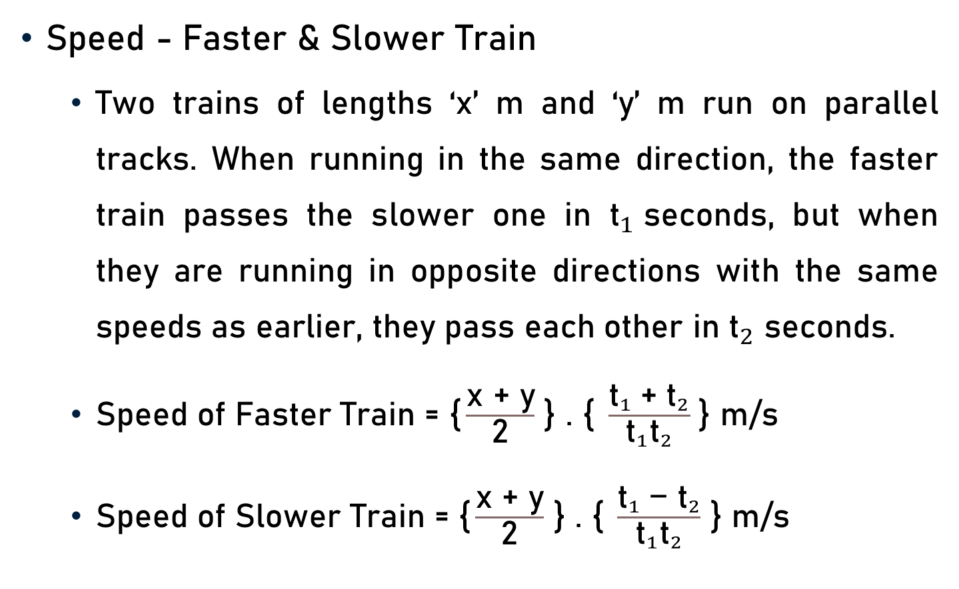
Basics, Important Facts and Formulae
Speed - Faster & Slower Train
  Two trains of lengths ‘x’ m and ‘y’ m run on parallel tracks. When running in the same direction, the faster train passes the slower one in ${\text{t}}_{1}$seconds, but when they are running in opposite directions with the same speeds as earlier, they pass each other in ${\text{t}}_{2}$ seconds.
  Speed of Faster Train = $\text{\{}\frac{\text{x} \text{+} \text{y}}{\text{2}}$ } . $\text{\{} \frac{{{\text{t}}_{1} \text{+ }\text{t}}_{2}}{{\text{t}}_{1}{\text{t}}_{2}}$ } m/s
  Speed of Slower Train = $\text{\{}\frac{\text{x}\text{ + }\text{y}}{\text{2}}$ } . $\text{\{} \frac{{{\text{t}}_{1} \text{− }\text{t}}_{2}}{{\text{t}}_{1}{\text{t}}_{2}}$ } m/s

Slide 10
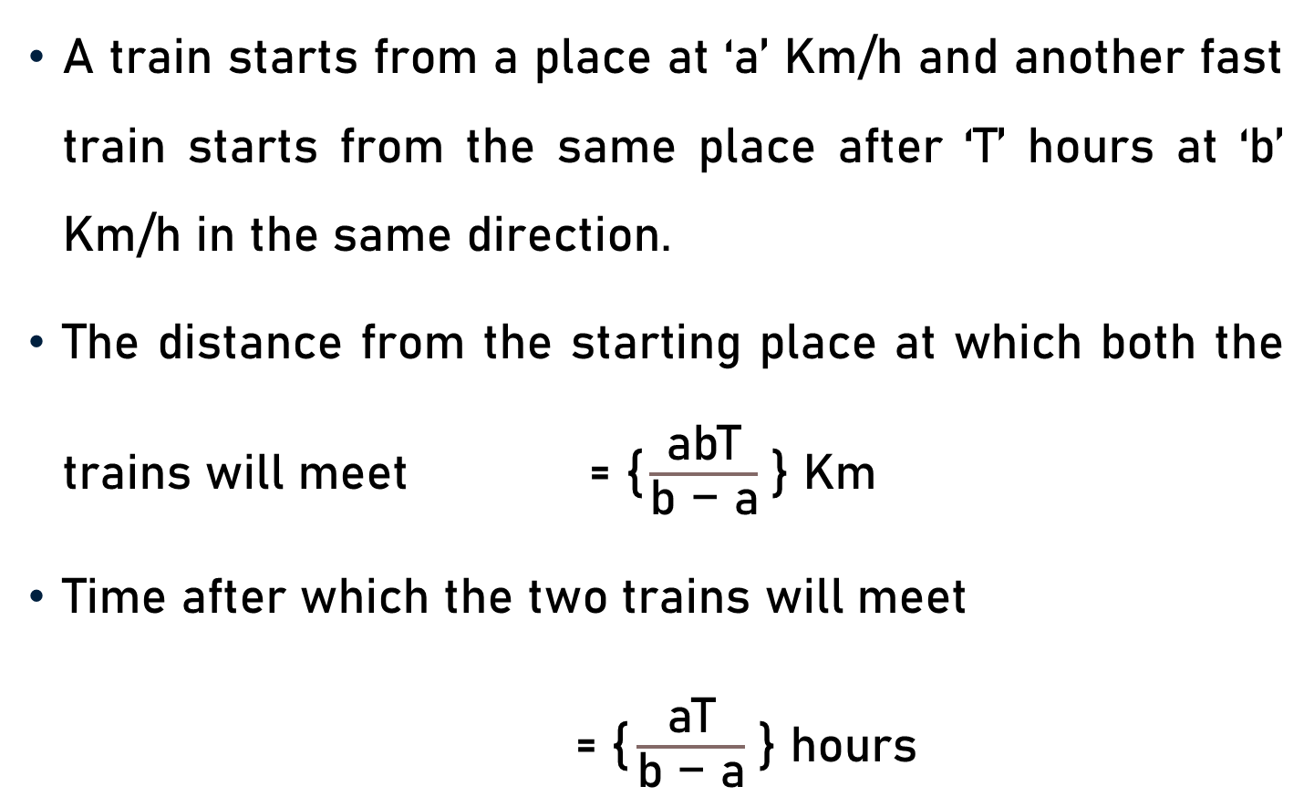
Important Facts and Formulae
A train starts from a place at ‘a’ Km/h and another fast train starts from the same place after ‘T’ hours at ‘b’ Km/h in the same direction.
The distance from the starting place at which both the trains will meet $\text{ = }\text{\{}\frac{\text{abT}}{\text{b}\text{ − }\text{a}}$ } Km
Time after which the two trains will meet
= $\text{\{}\frac{\text{a}\text{T}}{\text{b} \text{−} \text{a}}$ } hours

Slide 11
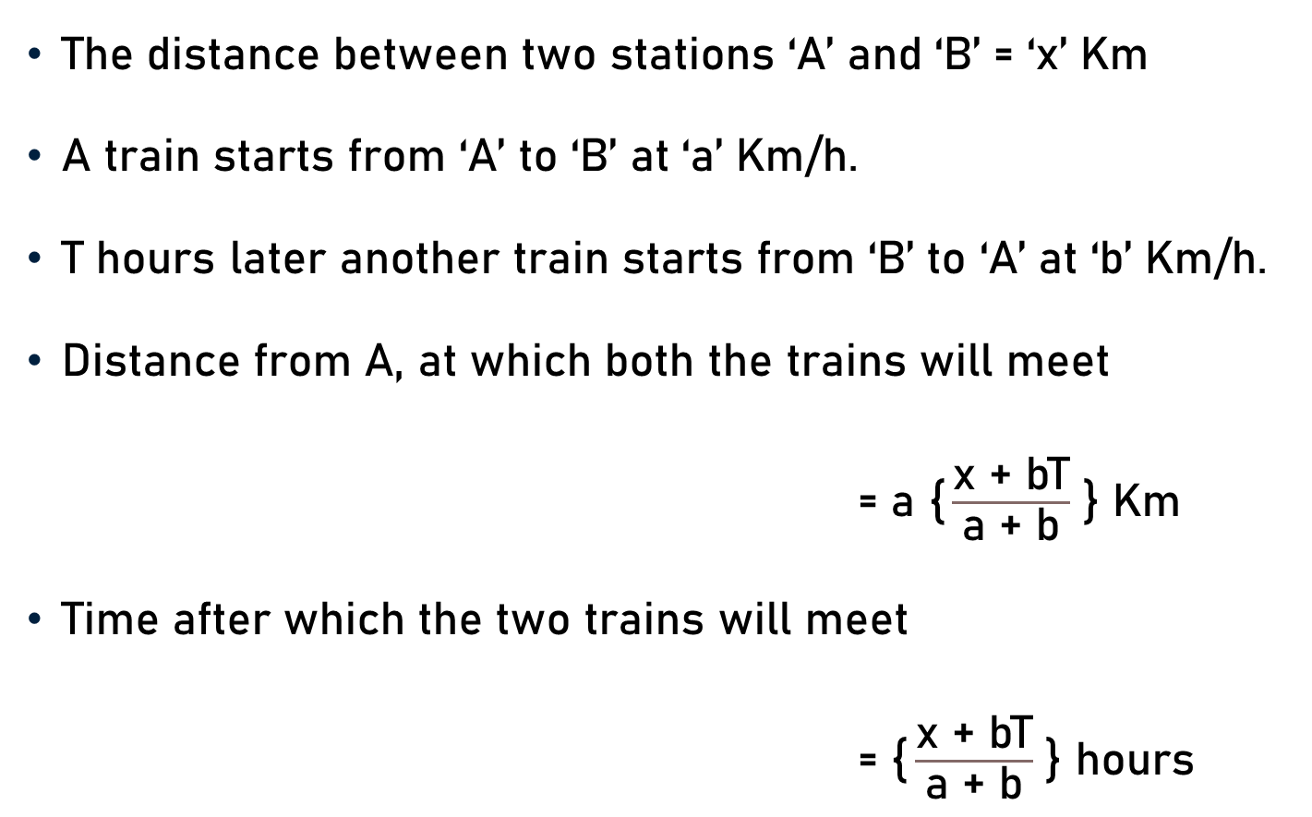
Important Facts and Formulae
The distance between two stations ‘A’ and ‘B’ = ‘x’ Km
A train starts from ‘A’ to ‘B’ at ‘a’ Km/h.
T hours later another train starts from ‘B’ to ‘A’ at ‘b’ Km/h.
Distance from A, at which both the trains will meet
= $\text{a}$ $\text{\{}\frac{\text{x}\text{ + }\text{bT}}{\text{a} \text{+} \text{b}}$ } Km
Time after which the two trains will meet
= $\text{\{}\frac{\text{x}\text{ + }\text{bT}}{\text{a}\text{ + }\text{b}}$ } hours

Slide 12
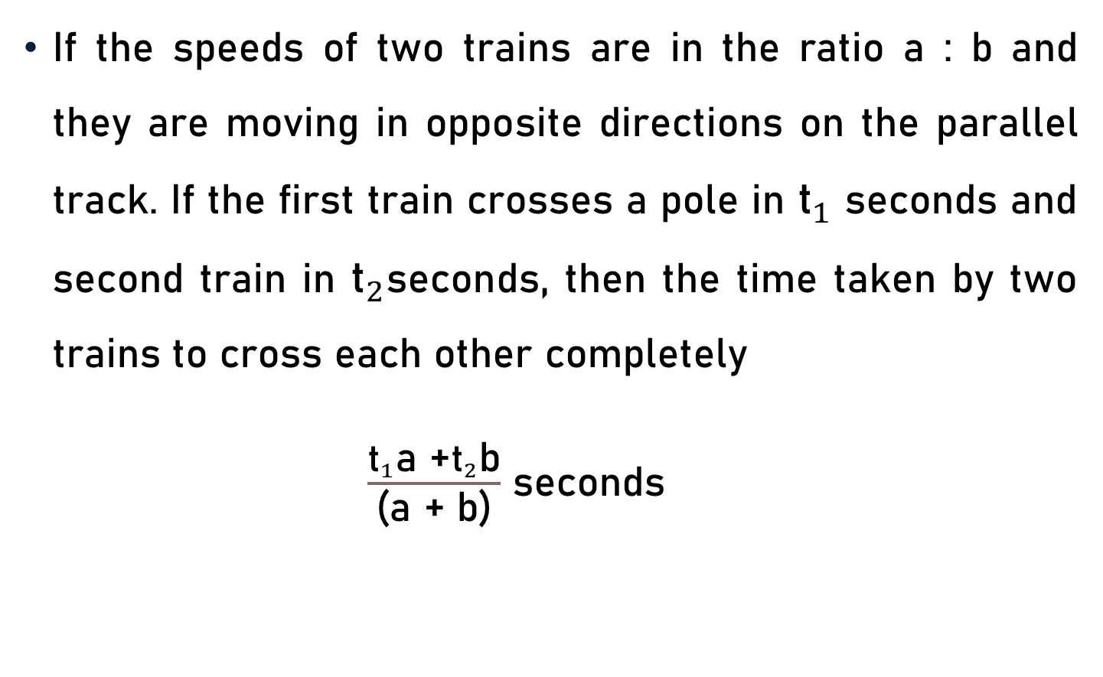
Important Facts and Formulae
If the speeds of two trains are in the ratio a : b and they are moving in opposite directions on the parallel track. If the first train crosses a pole in ${\text{t}}_{1}$ seconds and second train in ${\text{t}}_{2}$seconds, then the time taken by two trains to cross each other completely
$\frac{{\text{t}}_{1}\text{a}\text{ +}{\text{t}}_{2}\text{b}}{\text{(}\text{a} \text{+} \text{b}\text{)}}$ seconds

Slide 13
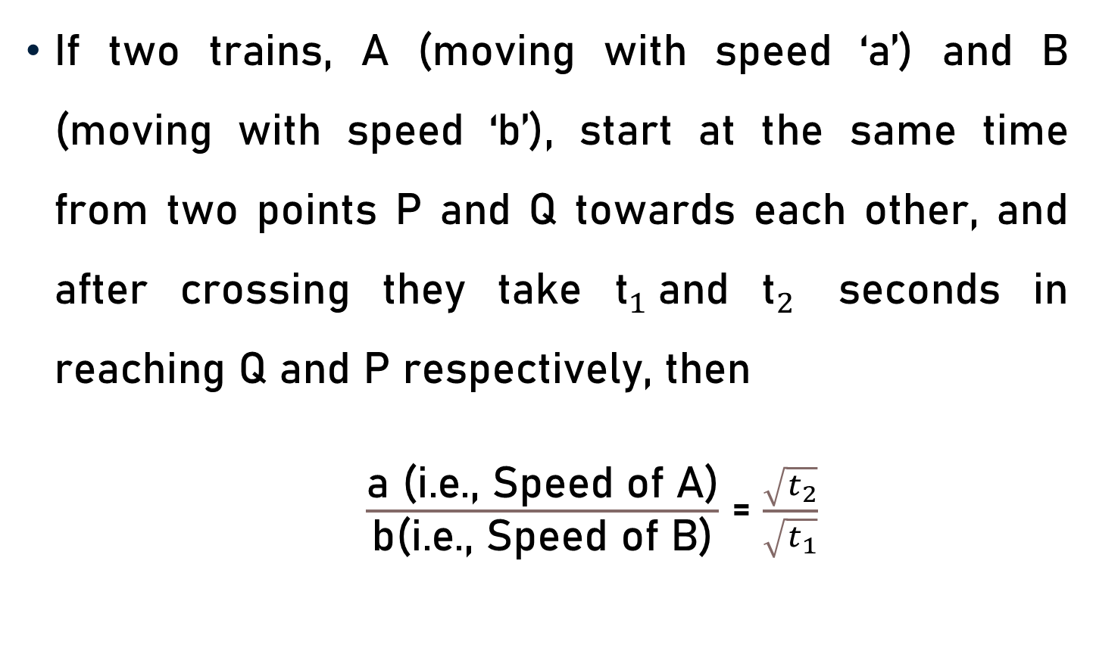
Important Facts and Formulae
If two trains, A (moving with speed ‘a’) and B (moving with speed ‘b’), start at the same time from two points P and Q towards each other, and after crossing they take ${\text{t}}_{1}$and ${\text{t}}_{2}$ seconds in reaching Q and P respectively, then
$\frac{\text{a}\text{ (}\text{i}\text{.}\text{e}\text{., }\text{Speed} \text{of} \text{A}\text{)}}{\text{b}\text{(}\text{i}\text{.}\text{e}\text{., }\text{Speed} \text{of} \text{B}\text{)}}$ = $\frac{\sqrt{t_{2}}}{\sqrt{t_{1}}}$

Slide 14
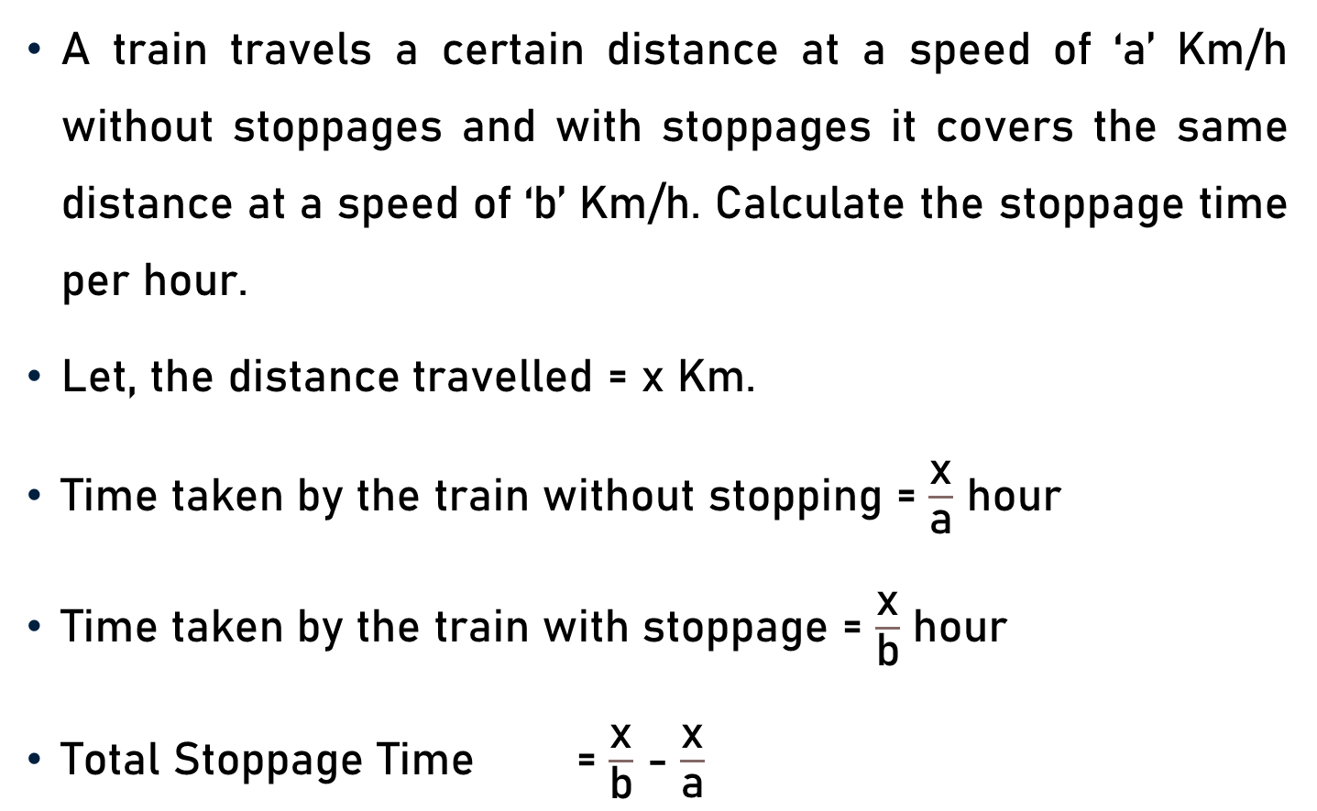
Important Facts and Formulae
A train travels a certain distance at a speed of ‘a’ Km/h without stoppages and with stoppages it covers the same distance at a speed of ‘b’ Km/h. Calculate the stoppage time per hour.
Let, the distance travelled = x Km.
Time taken by the train without stopping = $\frac{\text{x}}{\text{a}}$ hour
Time taken by the train with stoppage = $\frac{\text{x}}{\text{b}}$ hour
Total Stoppage Time = $\frac{\text{x}}{\text{b}}$ - $\frac{\text{x}}{\text{a}}$

Slide 15
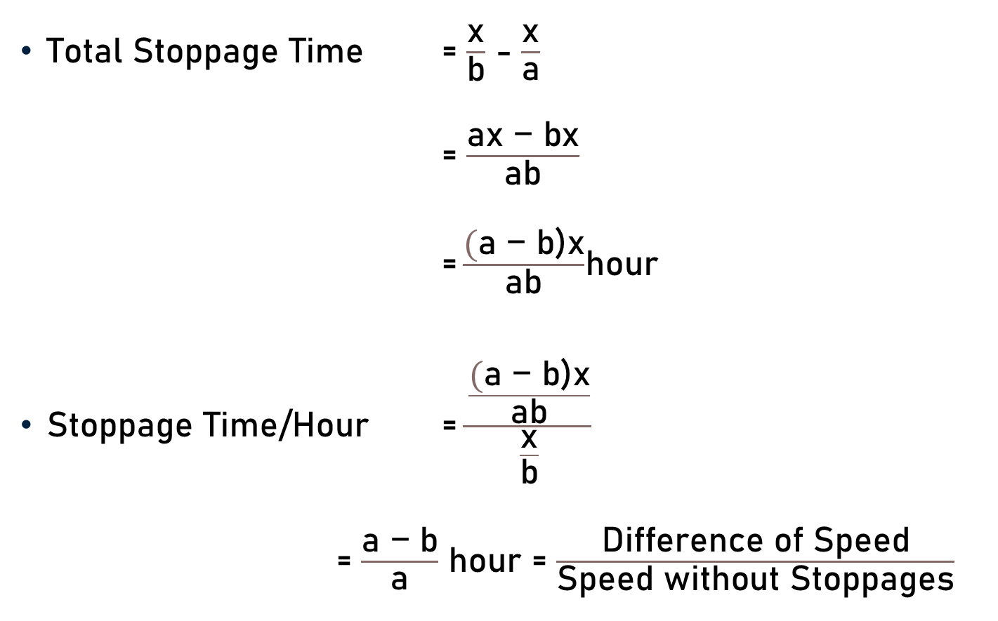
Important Facts and Formulae
Total Stoppage Time = $\frac{\text{x}}{\text{b}}$ - $\frac{\text{x}}{\text{a}}$
= $\frac{\text{a}\text{x}\text{ − }\text{b}\text{x}}{\text{ab}}$
$\text{=}\frac{\text{(}\text{a}\text{ − }\text{b}\text{)}\text{x}}{\text{ab}}$hour
Stoppage Time/Hour = $\frac{\frac{\text{(}\text{a}\text{ − }\text{b}\text{)}\text{x}}{\text{ab}}}{\frac{\text{x}}{\text{b}}}$
= $\frac{\text{a}\text{ − }\text{b}}{\text{a}}$ hour = $\frac{\text{Difference} \text{of} \text{S}\text{peed}}{\text{Speed} \text{without} \text{S}\text{toppages}}$

Slide 16
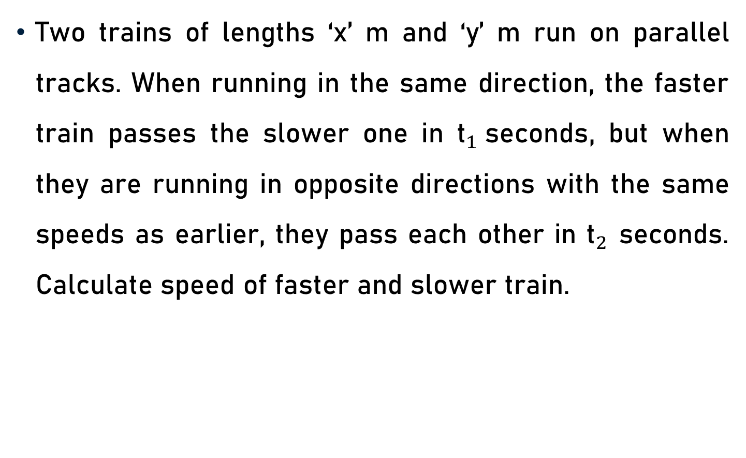
Important Facts and Formulae
Two trains of lengths ‘x’ m and ‘y’ m run on parallel tracks. When running in the same direction, the faster train passes the slower one in ${\text{t}}_{1}$seconds, but when they are running in opposite directions with the same speeds as earlier, they pass each other in ${\text{t}}_{2}$ seconds. Calculate speed of faster and slower train.

Slide 17
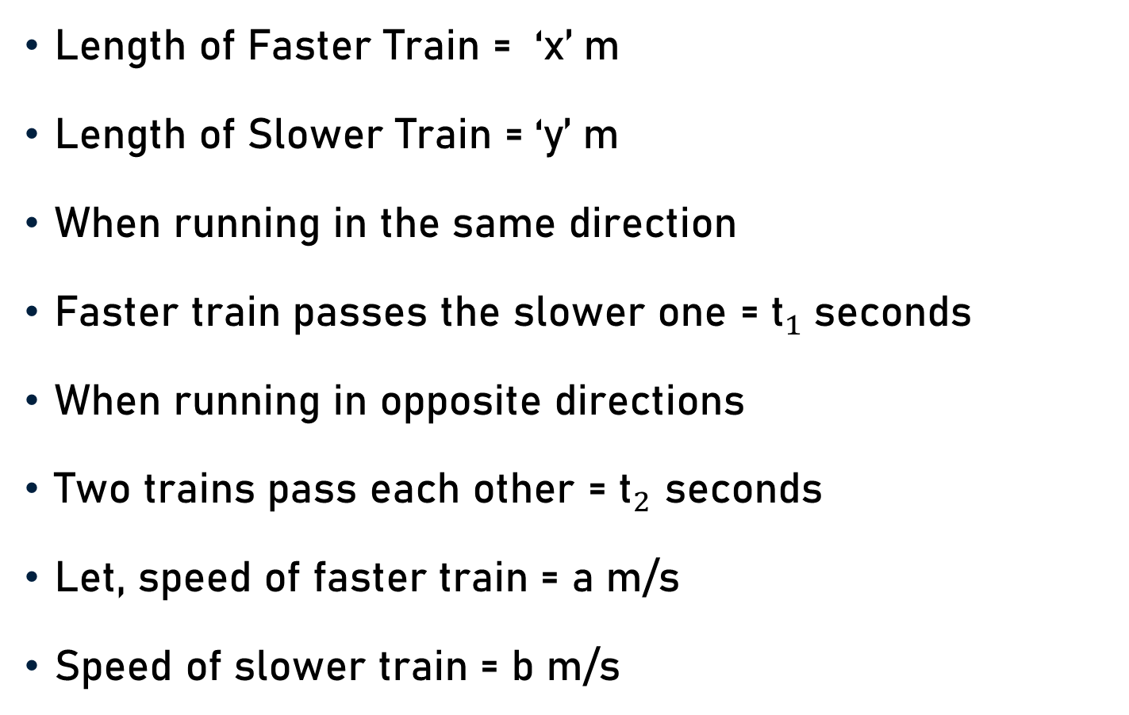
Important Facts and Formulae
Length of Faster Train = ‘x’ m
Length of Slower Train = ‘y’ m
When running in the same direction
Faster train passes the slower one = ${\text{t}}_{1}$seconds
When running in opposite directions
Two trains pass each other = ${\text{t}}_{2}$ seconds
Let, speed of faster train = a m/s
Speed of slower train = b m/s

Slide 18
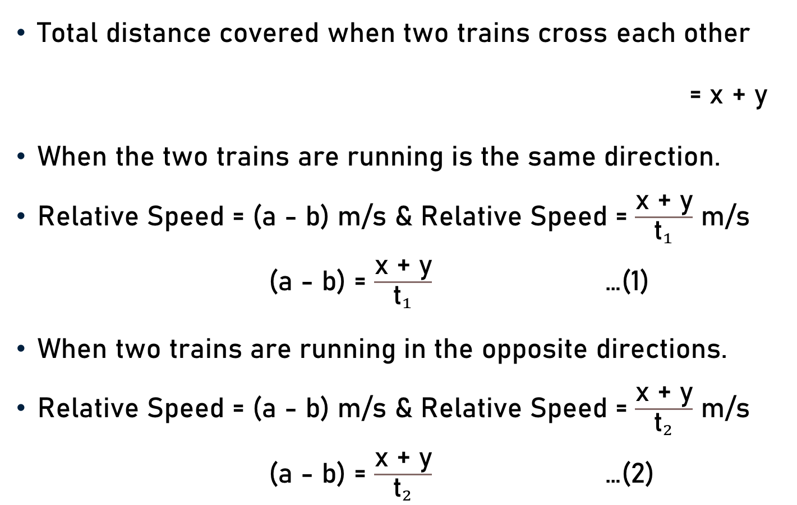
Important Facts and Formulae
Total distance covered when two trains cross each other
= x + y
When the two trains are running is the same direction.
Relative Speed = (a - b) m/s & Relative Speed = $\frac{\text{x}\text{ + }\text{y}}{{\text{t}}_{1}}$ m/s
(a - b) = $\frac{\text{x}\text{ + }\text{y}}{{\text{t}}_{1}}$ …(1)
When two trains are running in the opposite directions.
Relative Speed = (a - b) m/s & Relative Speed = $\frac{\text{x}\text{ + }\text{y}}{{\text{t}}_{2}}$ m/s
(a - b) = $\frac{\text{x}\text{ + }\text{y}}{{\text{t}}_{2}}$ …(2)

Slide 19



Important Facts and Formulae
(a - b) = $\frac{\text{x}\text{ + }\text{y}}{{\text{t}}_{1}}$ …(1) & (a + b) = $\frac{\text{x}\text{ + }\text{y}}{{\text{t}}_{2}}$ …(2)
(1) + (2)
2a = ($\text{x}\text{ + }\text{y}$) { $\frac{\text{1}}{{\text{t}}_{1}}$+ $\frac{\text{1} }{{\text{t}}_{2}}$ }
a = ($\frac{\text{x}\text{ + }\text{y}}{\text{2}}$) { $\frac{{{\text{t}}_{2} \text{+} \text{t}}_{1}}{{\text{t}}_{1}{\text{t}}_{2}}$ }
Speed of Faster Train = a
= ($\frac{\text{x}\text{ + }\text{y}}{\text{2}}$) { $\frac{{{\text{t}}_{1} \text{+ }\text{t}}_{2}}{{\text{t}}_{1}{\text{t}}_{2}}$ }
(2) – (1)
2b = ($\text{x} \text{+} \text{y}$) {$\frac{\text{1} }{{\text{t}}_{2}}$- $\frac{\text{1}}{{\text{t}}_{1}}$}
b = ($\frac{\text{x}\text{ + }\text{y}}{\text{2}}$) { $\frac{{{\text{t}}_{1} \text{−} \text{t}}_{2}}{{\text{t}}_{1}{\text{t}}_{2}}$ }
Speed of Slower Train = b
= ($\frac{\text{x}\text{ + }\text{y}}{\text{2}}$) { $\frac{{{\text{t}}_{1} \text{− }\text{t}}_{2}}{{\text{t}}_{1}{\text{t}}_{2}}$ }

Slide 20
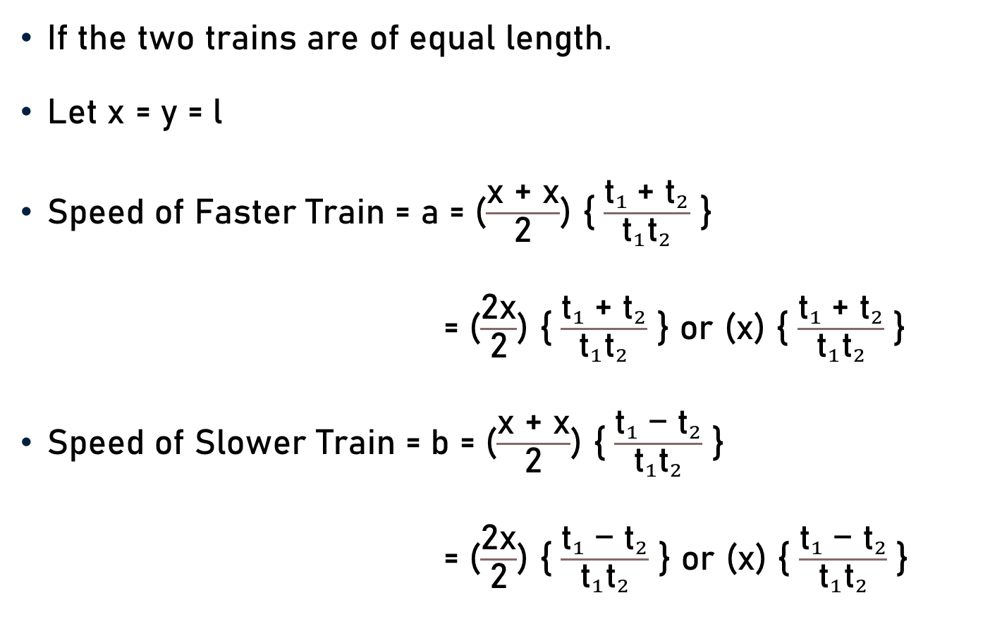
Important Facts and Formulae
If the two trains are of equal length.
Let x = y = l
Speed of Faster Train = a = ($\frac{\text{x}\text{ + }\text{x}}{\text{2}}$) { $\frac{{{\text{t}}_{1} \text{+ }\text{t}}_{2}}{{\text{t}}_{1}{\text{t}}_{2}}$ }
= ($\frac{\text{2}\text{x}}{\text{2}}$) { $\frac{{{\text{t}}_{1} \text{+ }\text{t}}_{2}}{{\text{t}}_{1}{\text{t}}_{2}}$ } or ($\text{x}$) { $\frac{{{\text{t}}_{1} \text{+ }\text{t}}_{2}}{{\text{t}}_{1}{\text{t}}_{2}}$ }
Speed of Slower Train = b = ($\frac{\text{x}\text{ + }\text{x}}{\text{2}}$) { $\frac{{{\text{t}}_{1} \text{− }\text{t}}_{2}}{{\text{t}}_{1}{\text{t}}_{2}}$ }
= ($\frac{\text{2}\text{x}}{\text{2}}$) { $\frac{{{\text{t}}_{1} \text{− }\text{t}}_{2}}{{\text{t}}_{1}{\text{t}}_{2}}$ } or ($\text{x}$) { $\frac{{{\text{t}}_{1} \text{− }\text{t}}_{2}}{{\text{t}}_{1}{\text{t}}_{2}}$ }

Slide 21
Important Facts and Formulae
Two trains start simultaneously from stations ‘A’ and ‘B’ towards each other with speeds a Km/h and b Km/h, respectively. When they meet it is found that the second train had travelled ‘x’ Km more than the first. Calculate distance between two stations.
Speed of first train = a Km/h & second train = b Km/h
Let, Distance between the two stations = ‘d’ Km
Let, Distance travelled by first train = ‘y’ Km
Distance travelled by second train = (y + x) Km

Slide 22
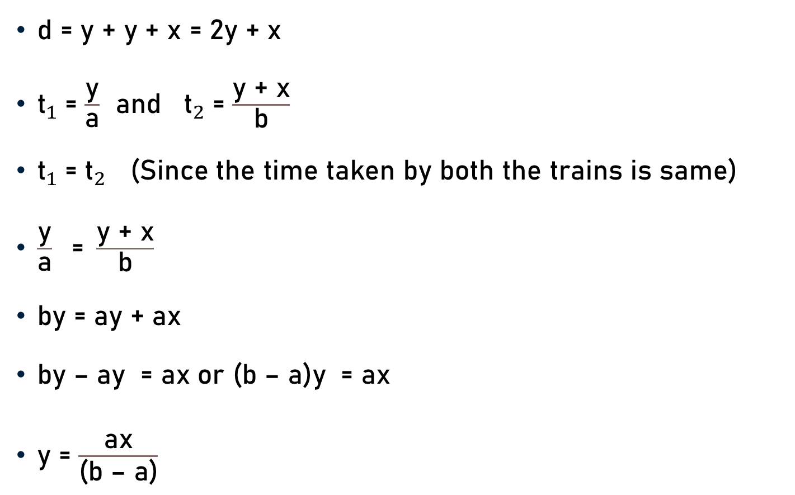
Important Facts and Formulae
d = y + y + x = 2y + x
${\text{t}}_{1}$= $\frac{\text{y}}{\text{a}}$ and ${\text{t}}_{2}$= $\frac{\text{y}\text{ + }\text{x}}{\text{b}}$
${\text{t}}_{1}$= ${\text{t}}_{2}$ (Since the time taken by both the trains is same)
$\frac{\text{y}}{\text{a}}\text{ = }\frac{\text{y}\text{ + }\text{x}}{\text{b}}$
by = ay + ax
by – ay = ax or (b – a)y = ax
y = $\frac{\text{ax}}{\text{(}\text{b}\text{ – }\text{a}\text{)}}$

Slide 23

Important Facts and Formulae
y = $\frac{\text{ax}}{\text{(}\text{b}\text{ – }\text{a}\text{)}}$
d = 2 $\frac{\text{ax}}{\text{(}\text{b}\text{ – }\text{a}\text{)}}$+ x
d = $\frac{\text{2}\text{ax} \text{+ }\text{x}\text{(}\text{b}\text{ – }\text{a}\text{)}}{\text{(}\text{b}\text{ – }\text{a}\text{)}}$
d = $\frac{\text{2}\text{ax}\text{ + }\text{bx}\text{ – }\text{ax}}{\text{(}\text{b}\text{ – }\text{a}\text{)}}$ = $\frac{\text{ax}\text{ + }\text{bx}}{\text{(}\text{b}\text{ – }\text{a}\text{)}}$
d = $\frac{\text{(}\text{a} \text{+ }\text{b}\text{)}\text{x}}{\text{(}\text{b}\text{ – }\text{a}\text{)}}$ Km

Slide 24
Conclusion
Distance covered by a train to overtake a pole/man/milestone = Length of Train
Distance covered by a train to overtake a bridge/tunnel/platform/another train = Length of the train + Length of bridge/tunnel/platform/another train

Slide 25
Conclusion
Time taken by a train of length ‘a’ m to pass a pole/standing man/milestone/signal post = Time taken by the train to cover ‘a’ m
Time taken by a train of length ‘a’ m to pass a stationary object/bridge/tunnel/platform/another train of length ‘b’ m = Time taken by train to cover (a + b) m

Slide 26
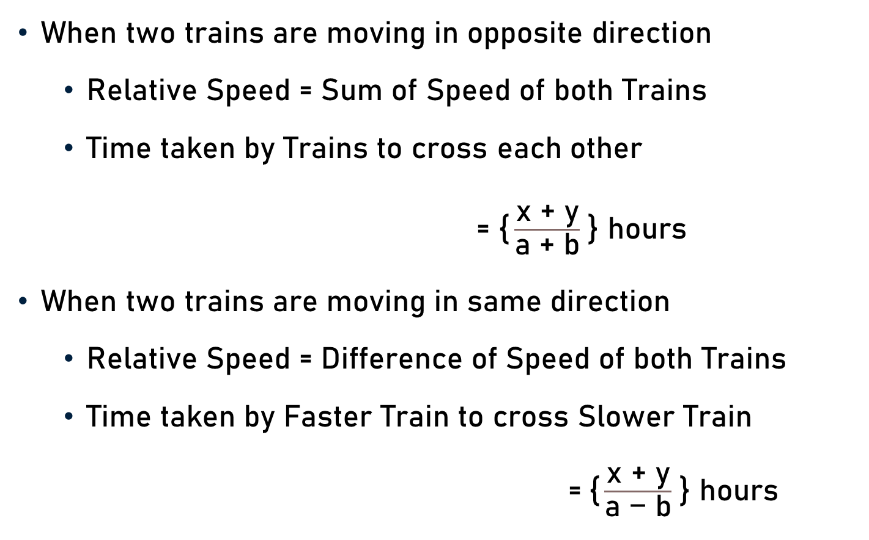
Conclusion
When two trains are moving in opposite direction
  Relative Speed = Sum of Speed of both Trains
  Time taken by Trains to cross each other
= $\text{\{}\frac{\text{x}\text{ + }\text{y}}{\text{a}\text{ + }\text{b}}$ } hours
When two trains are moving in same direction
  Relative Speed = Difference of Speed of both Trains
  Time taken by Faster Train to cross Slower Train
  =$\text{\{}\frac{\text{x}\text{ + }\text{y}}{\text{a}\text{ − }\text{b}}$ } hours

Slide 27

Conclusion
Two trains of lengths ‘x’ m and ‘y’ m run on parallel tracks. When running in same direction, faster train passes slower one in ${\text{t}}_{1}$seconds, but when they are running in opposite directions with same speeds as earlier, they pass each other in ${\text{t}}_{2}$ seconds.
  Speed of Faster Train = $\text{\{}\frac{\text{x}\text{ + }\text{y}}{\text{2}}$ } . $\text{\{} \frac{{{\text{t}}_{1} \text{+ }\text{t}}_{2}}{{\text{t}}_{1}{\text{t}}_{2}}$ } m/s
  Speed of Slower Train = $\text{\{}\frac{\text{x}\text{ + }\text{y}}{\text{2}}$ } . $\text{\{ }\frac{{{\text{t}}_{1} \text{− }\text{t}}_{2}}{{\text{t}}_{1}{\text{t}}_{2}}$ } m/s
If the two trains are of equal length.
  Speed of Faster Train = ($\text{x}$) { $\frac{{{\text{t}}_{1} \text{+ }\text{t}}_{2}}{{\text{t}}_{1}{\text{t}}_{2}}$ }
  Speed of Slower Train = ($\text{x}$) { $\frac{{{\text{t}}_{1} \text{− }\text{t}}_{2}}{{\text{t}}_{1}{\text{t}}_{2}}$ }

Slide 28
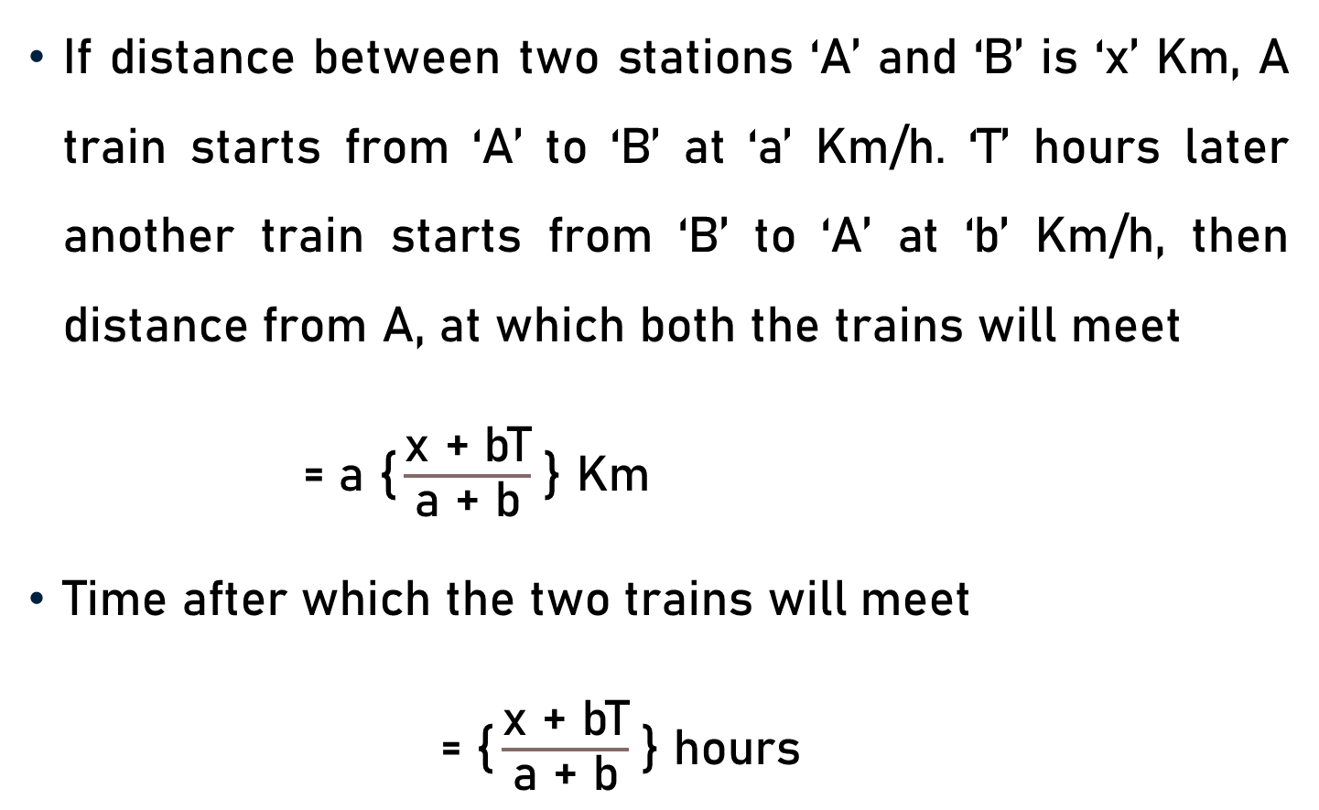
Conclusion
If distance between two stations ‘A’ and ‘B’ is ‘x’ Km, A train starts from ‘A’ to ‘B’ at ‘a’ Km/h. ‘T’ hours later another train starts from ‘B’ to ‘A’ at ‘b’ Km/h, then distance from A, at which both the trains will meet
= $\text{a}$ $\text{\{}\frac{\text{x}\text{ + }\text{bT}}{\text{a}\text{ + }\text{b}}$ } Km
Time after which the two trains will meet
= $\text{\{}\frac{\text{x}\text{ + }\text{bT}}{\text{a}\text{ + }\text{b}}$ } hours

Slide 29
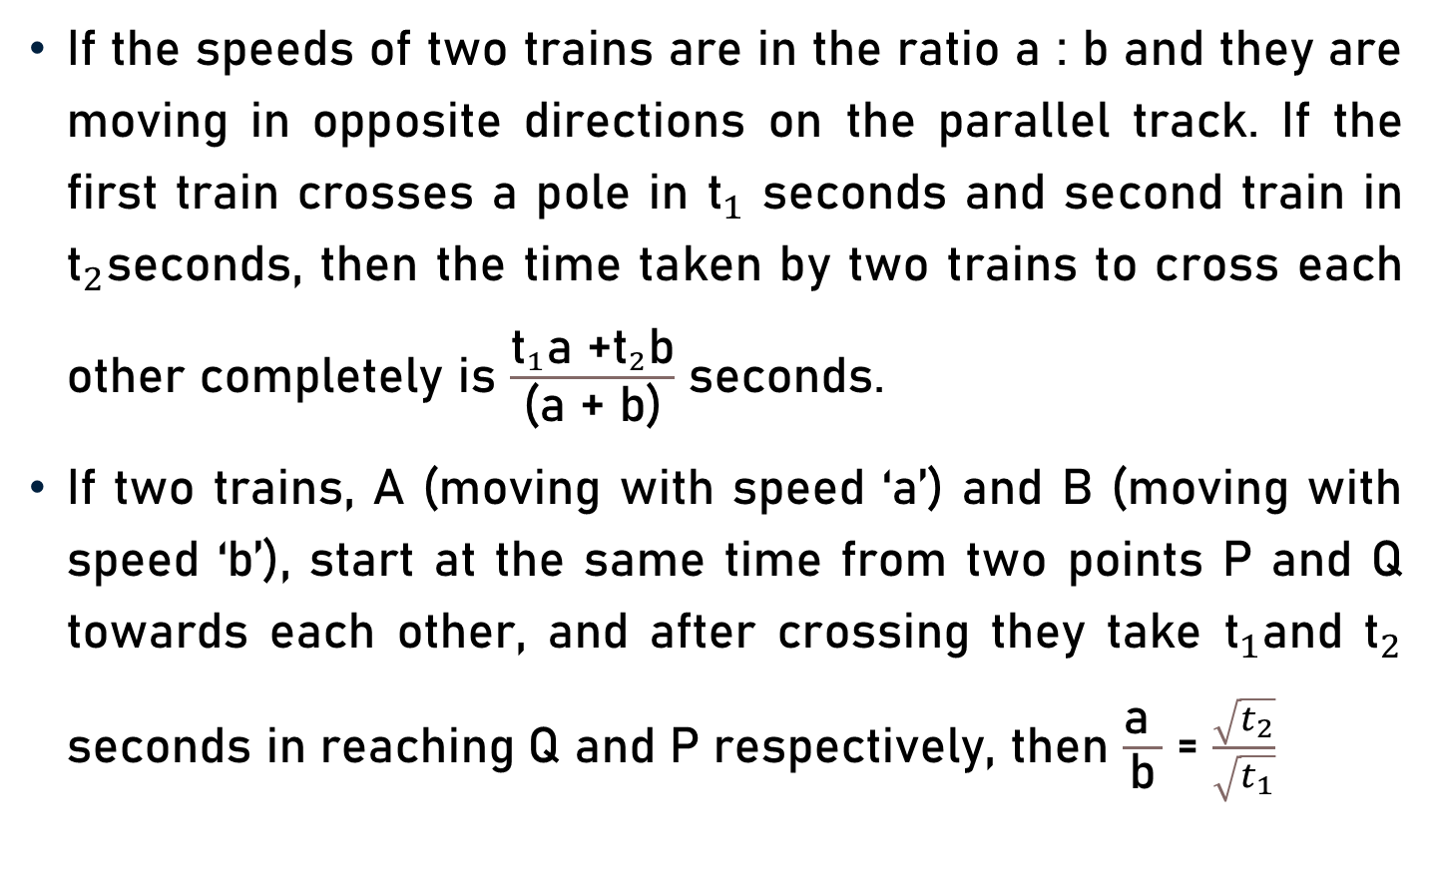
Conclusion
If the speeds of two trains are in the ratio a : b and they are moving in opposite directions on the parallel track. If the first train crosses a pole in ${\text{t}}_{1}$ seconds and second train in ${\text{t}}_{2}$seconds, then the time taken by two trains to cross each other completely is $\frac{{\text{t}}_{1}\text{a}\text{ +}{\text{t}}_{2}\text{b}}{\text{(}\text{a}\text{ + }\text{b}\text{)}}$ seconds.
If two trains, A (moving with speed ‘a’) and B (moving with speed ‘b’), start at the same time from two points P and Q towards each other, and after crossing they take ${\text{t}}_{1}$and ${\text{t}}_{2}$ seconds in reaching Q and P respectively, then $\frac{\text{a} }{\text{b}}$ = $\frac{\sqrt{t_{2}}}{\sqrt{t_{1}}}$

Slide 30
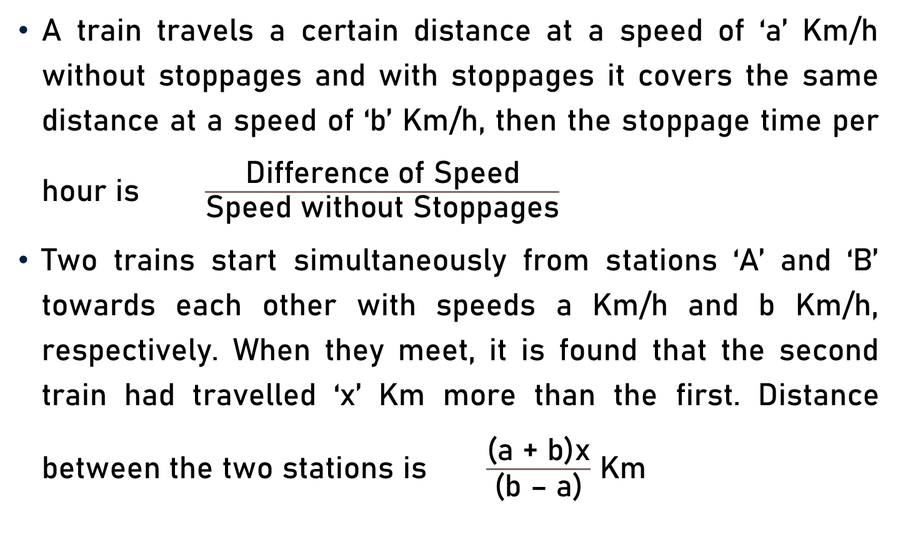
Conclusion
A train travels a certain distance at a speed of ‘a’ Km/h without stoppages and with stoppages it covers the same distance at a speed of ‘b’ Km/h, then the stoppage time per hour is $\frac{\text{Difference} \text{of} \text{Speed}}{\text{Speed} \text{without} \text{Stoppages}}$
Two trains start simultaneously from stations ‘A’ and ‘B’ towards each other with speeds a Km/h and b Km/h, respectively. When they meet, it is found that the second train had travelled ‘x’ Km more than the first. Distance between the two stations is $\frac{\text{(}\text{a}\text{ + }\text{b}\text{)}\text{x}}{\text{(}\text{b}\text{ – }\text{a}\text{)}}$ Km

Slide 31
Summary
Basics
  Relative Speed
  Faster & Slower Trains
Problems on Trains
  Important Facts
  Formulae

